Slide 1
Data Platforms - Under the hood
Manuele Pasini
manuele.pasini@unibo.it
09/12/2025
Intro
Who am I ?
Manuele Pasini, Ph.D. Candidate in Computer Science and Engineering
University of Bologna, Business Intelligence Group
Area of Interest:
(Almost) the whole data* world.
Data engineering (physical level);
Data integration;
Precision Agriculture:
Irrigation management;
Data Platform for italian agriculture domain @Agritech.
A Cloud Data Platform
Is a centralized infrastructre composed of independent and well-integrated services meeting the end-to-end needs of data pipelines:
Centralized: a data platform is conceptually a single and unified component;
Independent: changes in a a service do not affect others;
Well-integrated: services have interfaces enabling a frictionless composition;
End-to-end: services cover the entire data life cycle.
A case study - The Agritech PNRR Project
Goal: Build a data platform to foster collaboration and integration between different agriculture research projects.

Slide 2
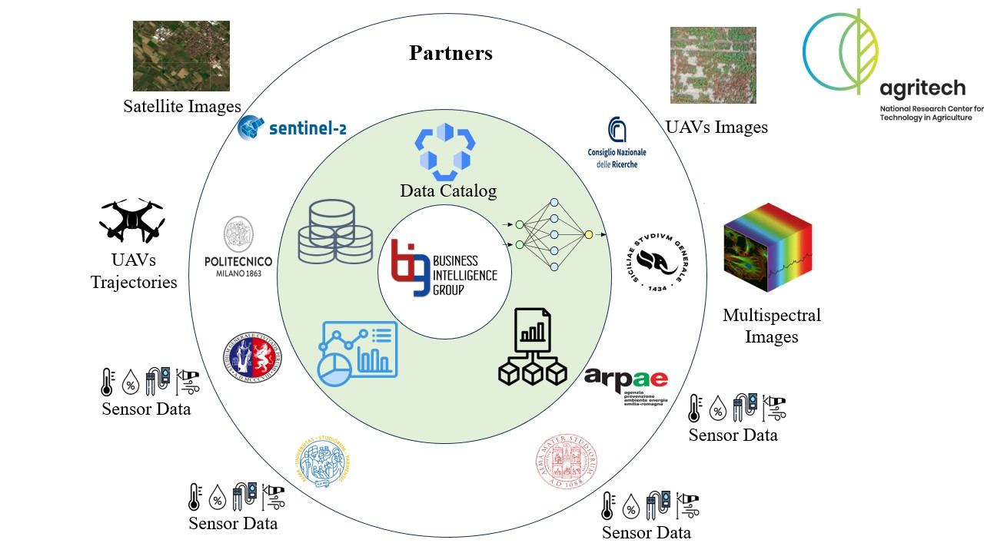
In short:
6 research partners;
highly heterogeneous data;
different goals;
Main challenges:
Data governance;
Resource governance;
Unforseen events.
Agritech project

Slide 3
About Governance…
Requirement gathering
We needed to identify key data aspects!
Process:
Two meetings with each partner;
Questionaires;
10 minutes presentation on their project;
Clear questions on the type of data managed.
Desired output: document key data (e.g., 5Vs) and processing requirements (e.g., GPUS) for each stakeholder.
About Governance…
Output
Identified key aspects:
Variety: Vector, image, multispectral, and sensor data.
Volume: From small sensor data to large drone missions.
Veracity: Managing data quality from non-IT personnel.
Heterogeneous domain:
multidisiplinary projects;
non-communicating partners;
data collected in standalone excel files;
few-to-none common ground for interoperability.
Project volatility:
Analysis goals could evolve through time;
data types could vary through time!
Towards a mesh architecture

Slide 4
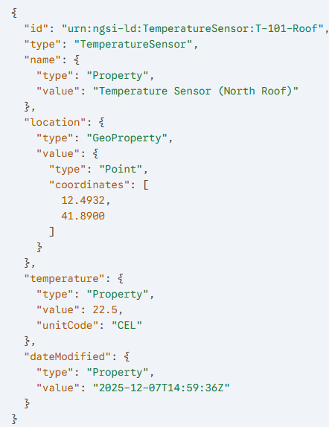
Centralized integration would be a nightmare!
1 ETL procedure x stakeholder;
hard to enforce data quality;
limited scalability (w.r.t. stakeholders).
Hybrid solution:
Centralized storage;
adherence to FIWARE Smart Data Models;
JSON descriptor attached to data;
Common glossary of terms;
geo-properties standardization.
Data as a product!
FIWARE Agrifood Smart Data Model example

Slide 5
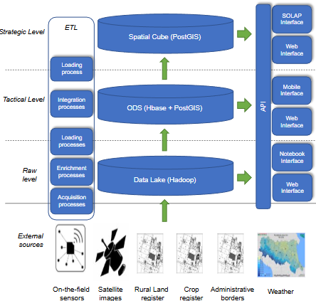
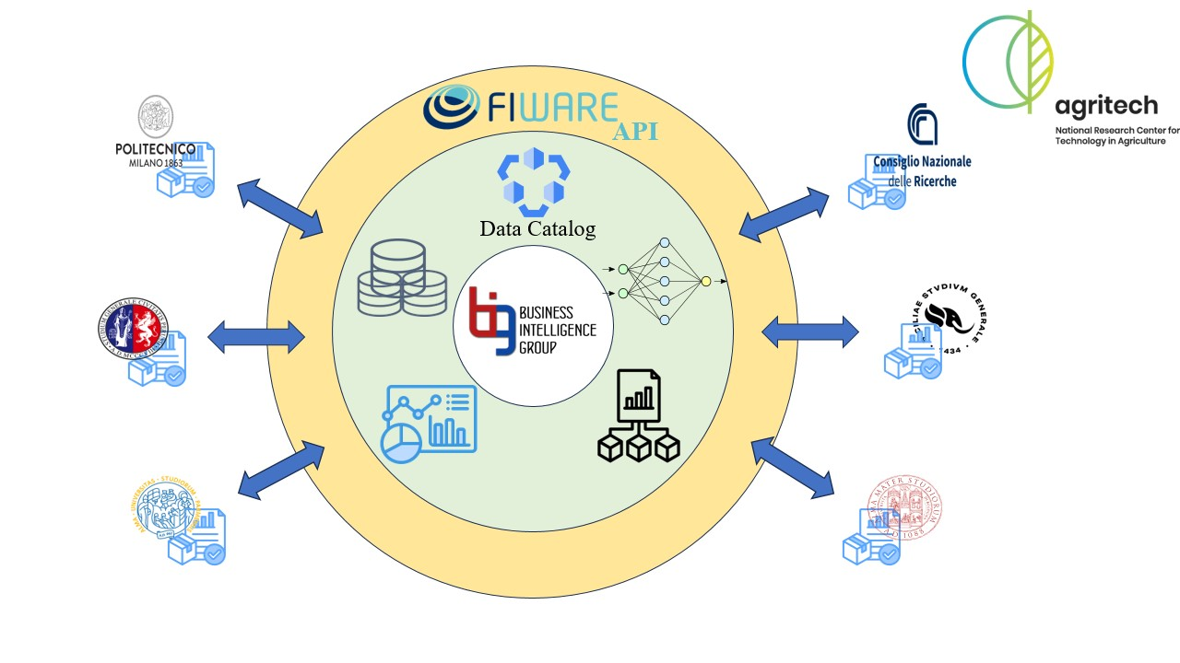
Agritech conceptual architecture
Agritech Conceptual Architecture
Agritech functional architecture

Slide 6
Let’s talk deploy!
On a hardware level

Slide 7
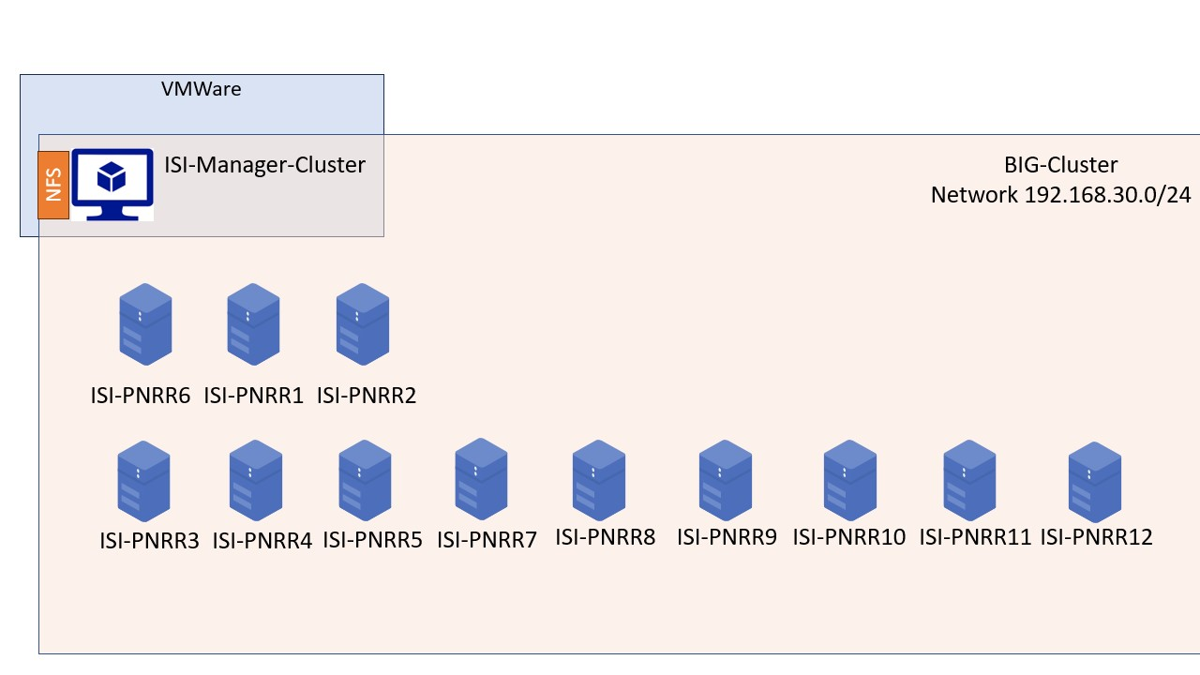
12 nodes (and counting…)
CPU 20 core w5-2445 @4.6 GHZ
256 GB RAM
12 TB HDD
2 GPUs NVIDIA RTX 6000 Ada Generation
1 Network File System (3 TB)
Hardware architecture

Slide 8
On a hardware level

Slide 9
We don’t really want to work on bare metal…
Need for fault tolerance mechanisms;
Possible dependencies issues;
no isolation .
… We want to virtualize
remember the independence constraint.
Docker Swarm !
Hardware + Docker architecture
Hardware + Docker architecture

Slide 10
A Docker overview
Docker is a platform for developing, shipping and running isolated application using container based virtualization technology.

Slide 11

w.r.t. virtual machines (e.g., VMWare):
more lightweight;
no guest OS;
reduced resource consumption;
more containers per host;
greater portability
Container vs. Virtual Machines

Slide 12
Docker Swarm
Swarm mode is an advanced feature for managing a cluster of Docker daemons.

Slide 13
Characteristics:
Integrated Orchestration;
Decentralized Management;
multi-host networking;
load balancing;
scaling features;
service discovery;
rolling updates
Docker swarm architecture

Slide 14
Building a Data Platform
Platform services as Docker services.
Logically organized in stacks
Docker swarm architecture
Docker swarm architecture
This is the what, but…
… Too many things in one-flat schema, we need to add another dimension.

Slide 15
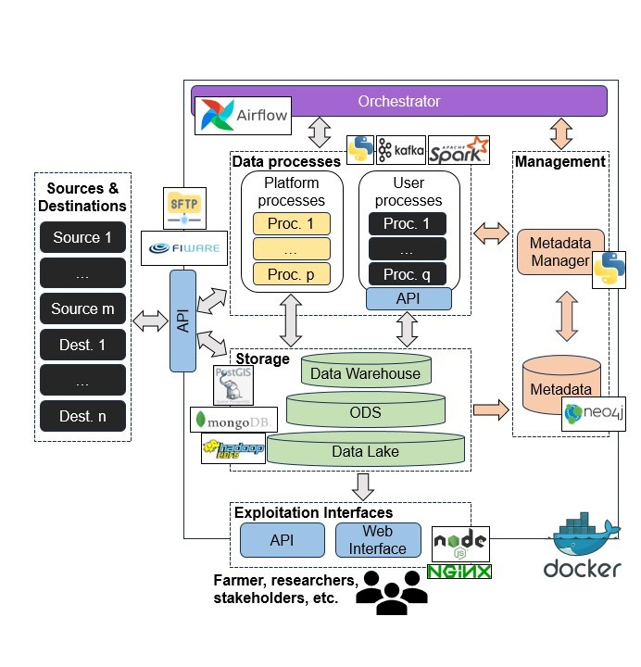
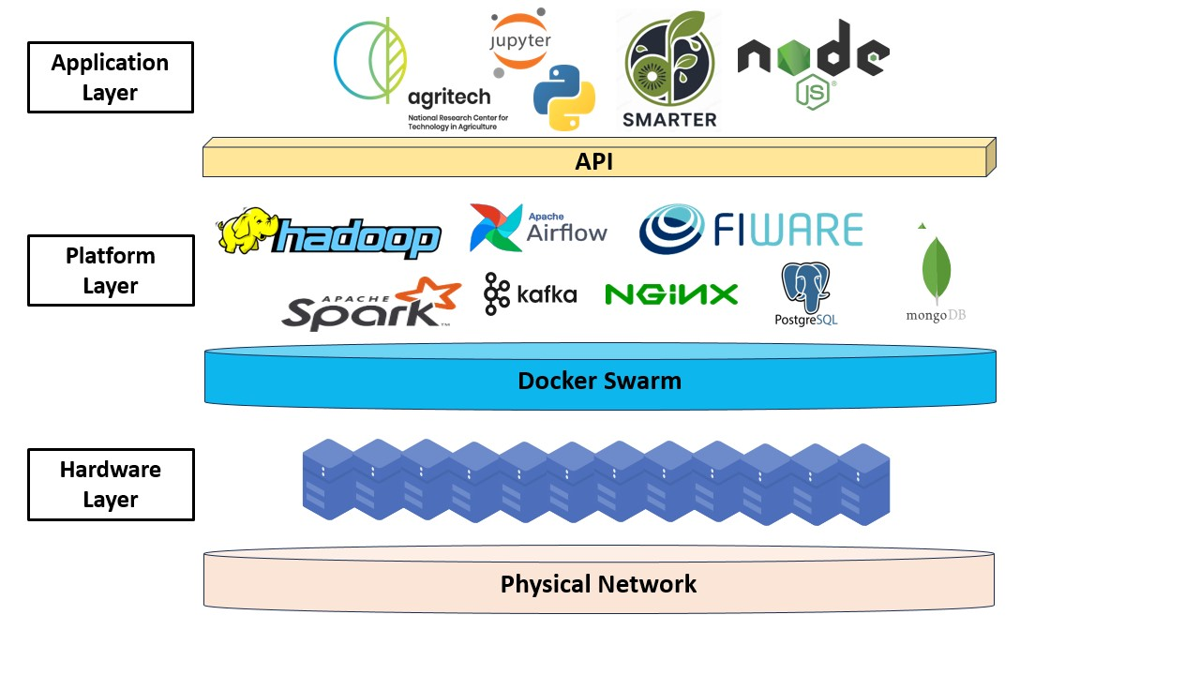
A perspective change
Now we know the where…
What about the how ?
A functional view
test2
Vertical view on BIG Data platform
Functional view

Slide 16
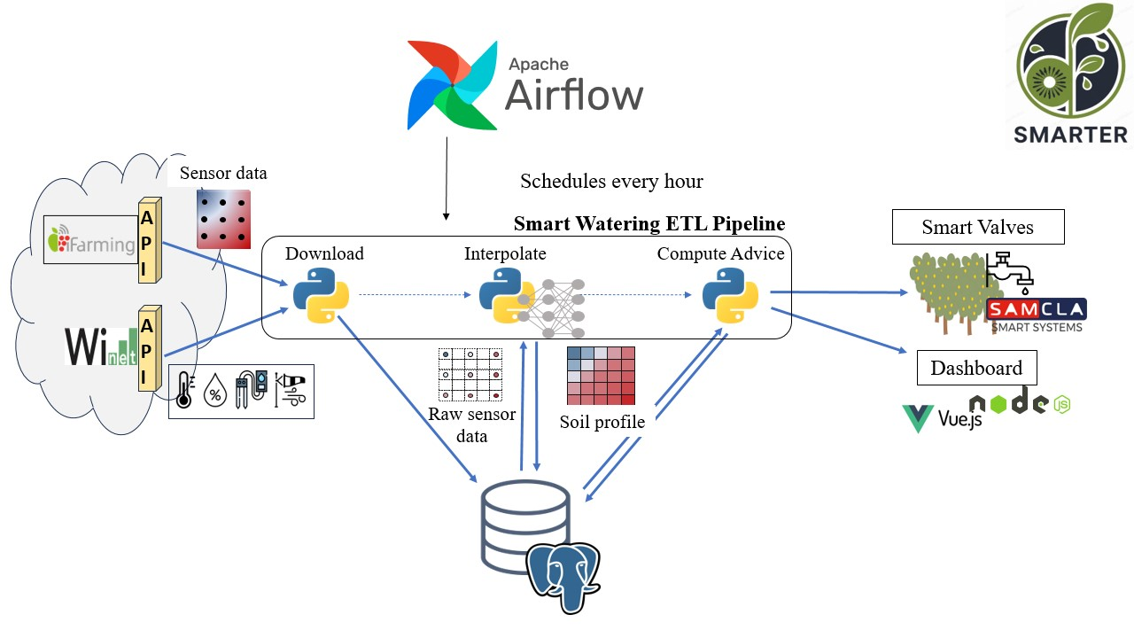
test3

Slide 17
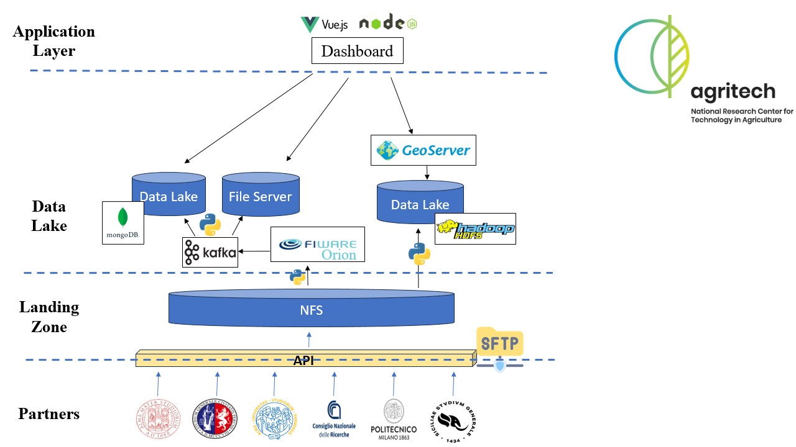
test4

Slide 18
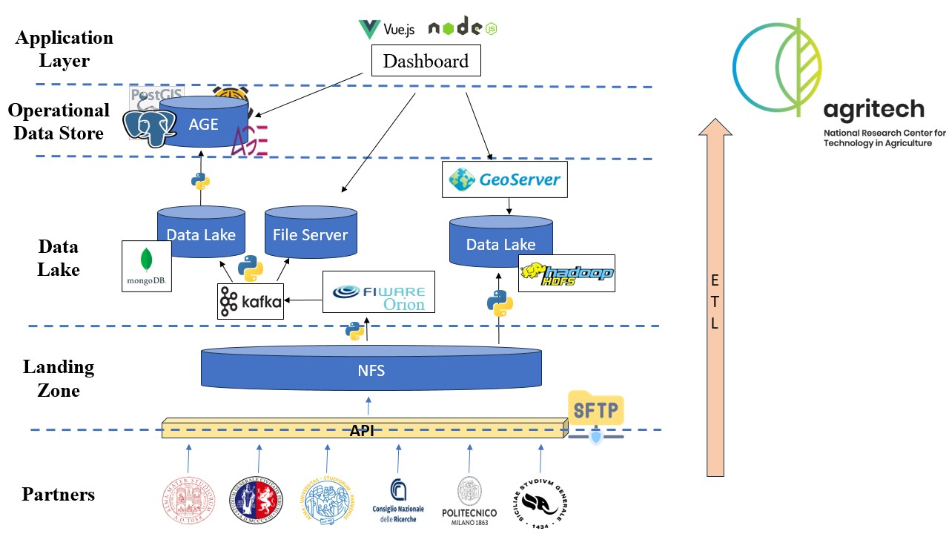
test5

Slide 19
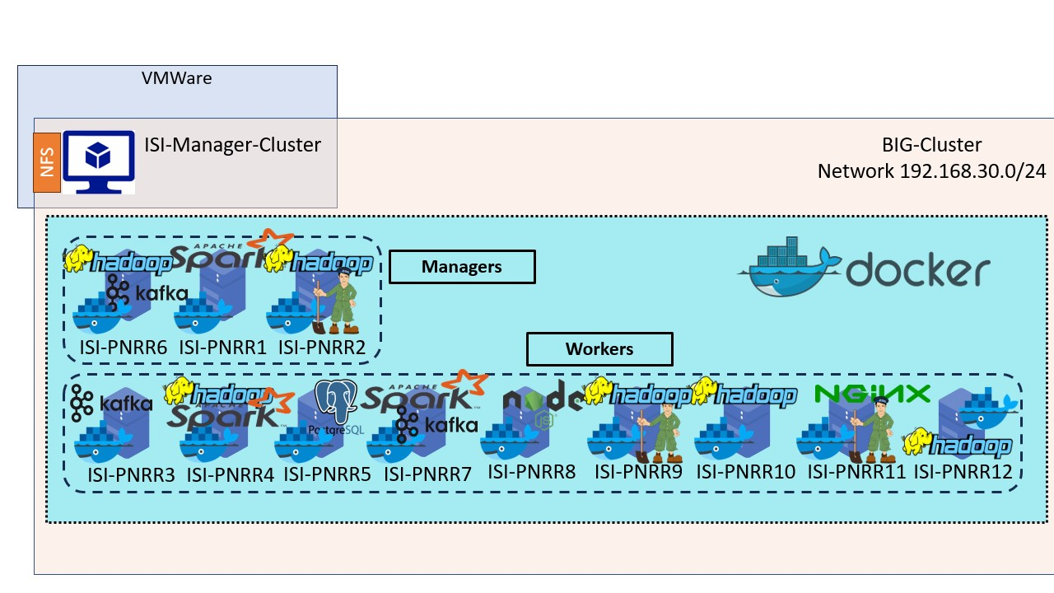
test6

Slide 20
test7

